Slide 1
Nonlinear Swing-up Controllers for the Pendulum, Acrobot, and Cart Pole
Logan Dihel
May 1st, 2023
[1] Russ Tedrake. Underactuated Robotics: Algorithms for Walking, Running, Swimming, Flying, and Manipulation (Course Notes for MIT 6.832).
[2] Mark W. Spong, "Energy Based Control of a Class of Underactuated Mechanical Systems", Proceedings of the 1996 IFAC World Congress , 1996

Slide 2

Inspiration

Slide 3
Outline
Introduction: Feedback Linearization (how to create our own dynamics)
Balancing Pendulum; Inverting gravity
Underactuated systems
Pendulum w/ input saturation
Acrobot
Cart Pole
Control of underactuated systems
Swing-up controller for Saturated Pendulum
Partial feedback linearization (PFL)
Swing-up control of Acrobot
Swing-up control of Cart Pole

Slide 4
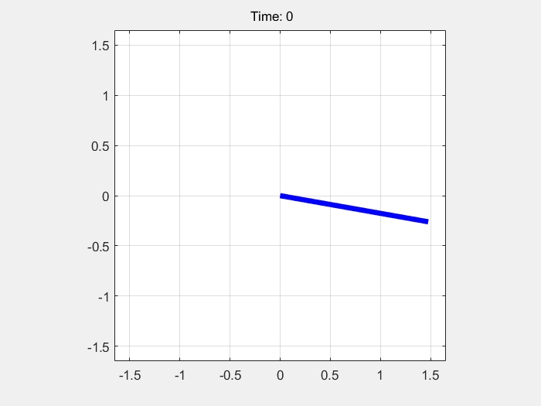
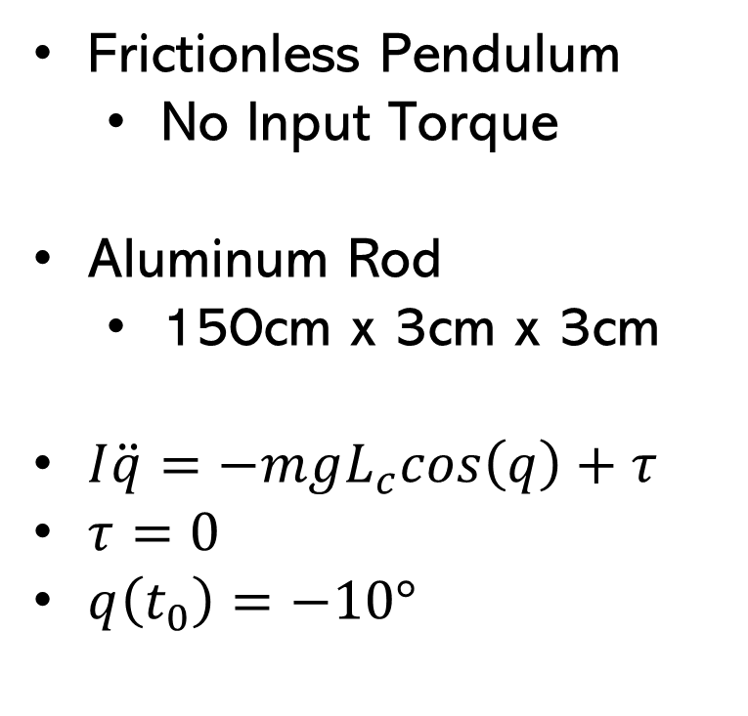
Pendulum – No Input
Frictionless Pendulum
No Input Torque
Aluminum Rod
150cm x 3cm x 3cm
$I\ddot{q}=−mgL_{c}cos\left(q\right)+τ$
$τ=0$
$q\left(t_{0}\right)=−10°$

Slide 5
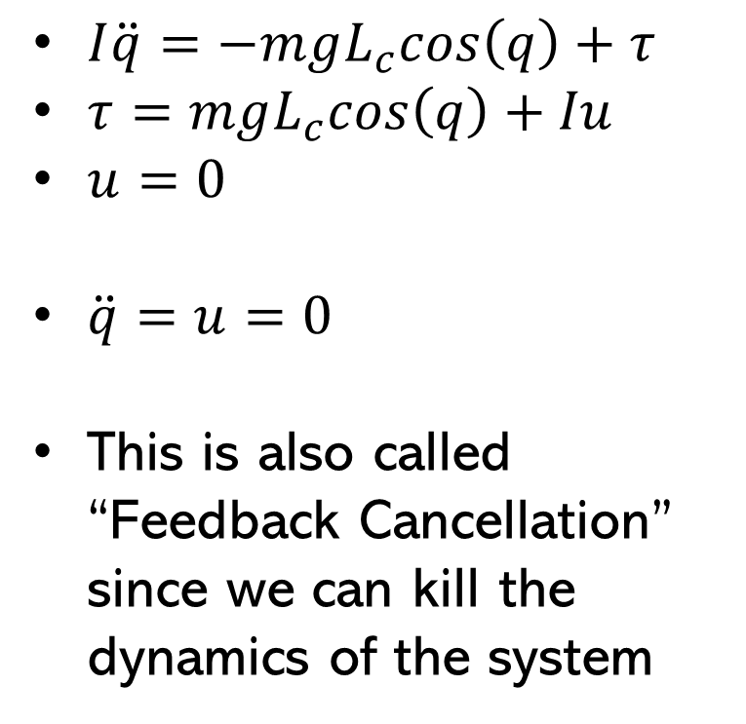
Feedback Linearization (FL)
$I\ddot{q}=−mgL_{c}cos\left(q\right)+τ$
$τ=mgL_{c}cos\left(q\right)+Iu$
$u=0$
$\ddot{q}=u=0$
This is also called “Feedback Cancellation” since we can kill the dynamics of the system

Slide 6
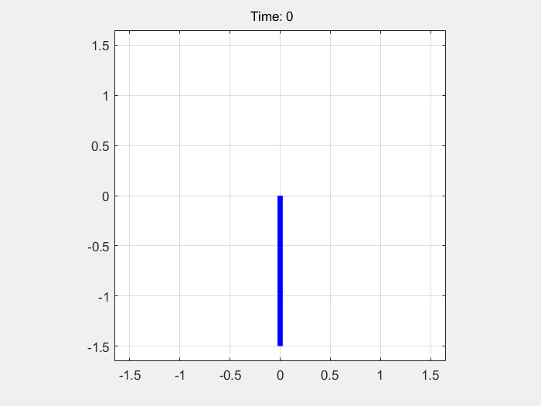
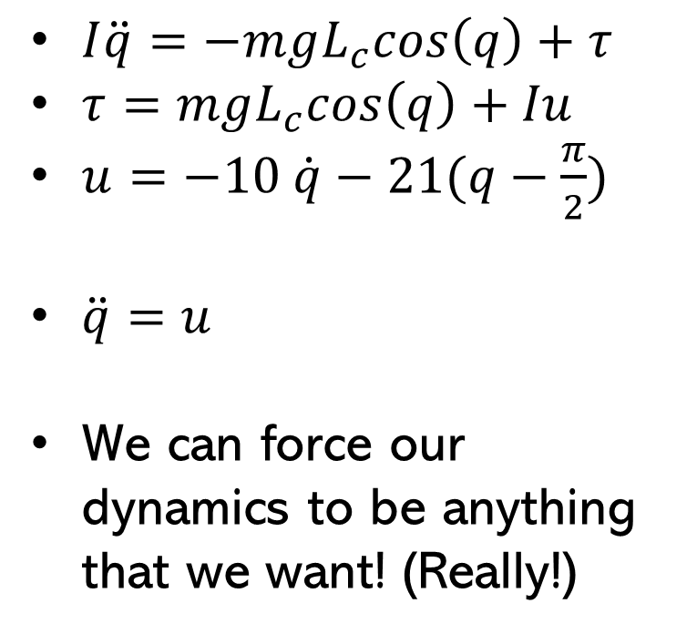
FL + PD Controller
$I\ddot{q}=−mgL_{c}cos\left(q\right)+τ$
$τ=mgL_{c}cos\left(q\right)+Iu$
$u=−10 \dot{q}−21(q−\frac{π}{2})$
$\ddot{q}=u$
We can force our dynamics to be anything that we want! (Really!)

Slide 7
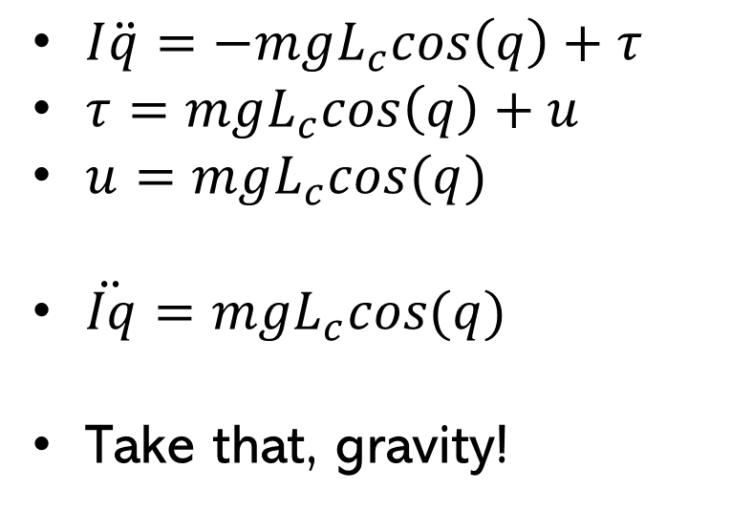
FL + Invert Gravity Controller
$I\ddot{q}=−mgL_{c}cos\left(q\right)+τ$
$τ=mgL_{c}cos\left(q\right)+u$
$u=mgL_{c}cos(q)$
$\ddot{Iq}=mgL_{c}cos(q)$
Take that, gravity!

Slide 8
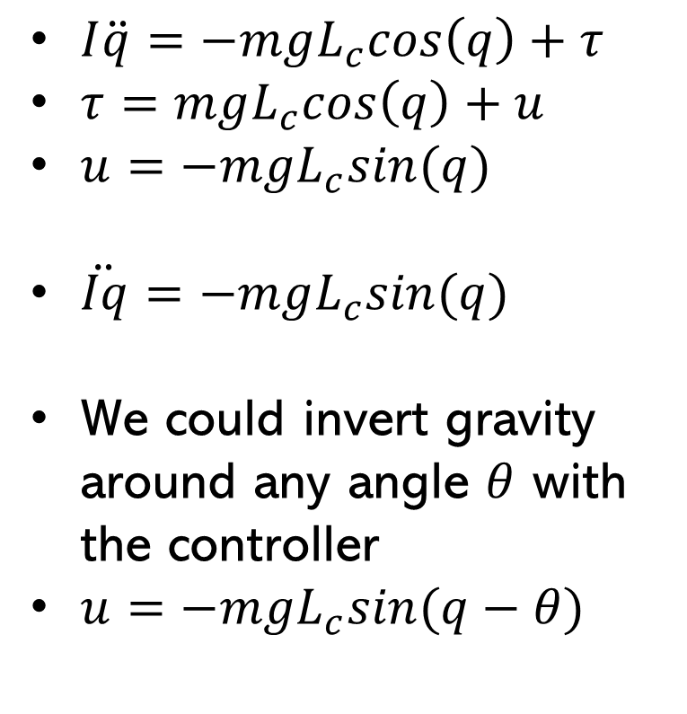
FL + Sideways Gravity Controller
$I\ddot{q}=−mgL_{c}cos\left(q\right)+τ$
$τ=mgL_{c}cos\left(q\right)+u$
$u=−mgL_{c}sin(q)$
$\ddot{Iq}=−mgL_{c}sin(q)$
We could invert gravity around any angle $θ$ with the controller
$u=−mgL_{c}sin(q−θ)$

Slide 9
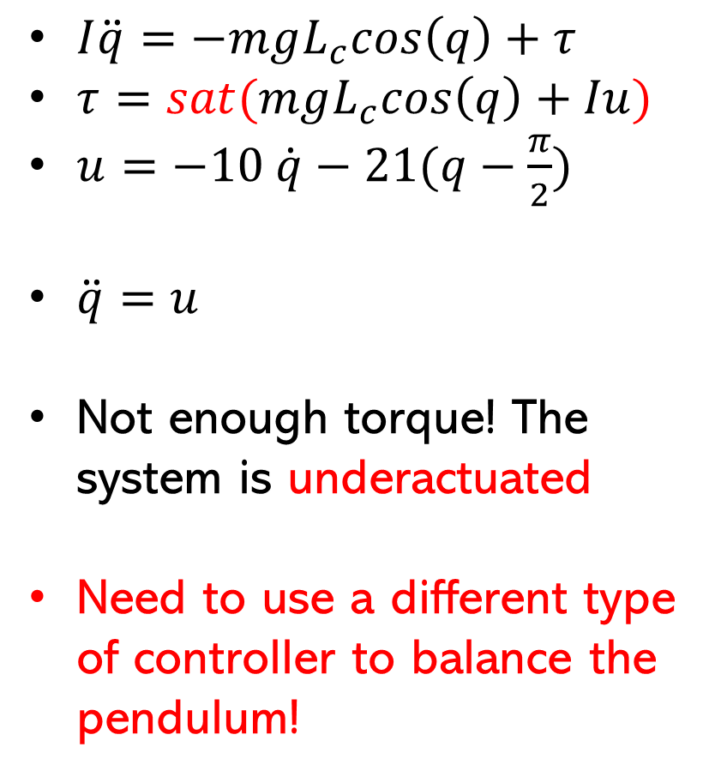
FL + PD + Saturation
$I\ddot{q}=−mgL_{c}cos\left(q\right)+τ$
$τ=sat(mgL_{c}cos\left(q\right)+Iu)$
$u=−10 \dot{q}−21(q−\frac{π}{2})$
$\ddot{q}=u$
Not enough torque! The system is underactuated
Need to use a different type of controller to balance the pendulum!

Slide 10
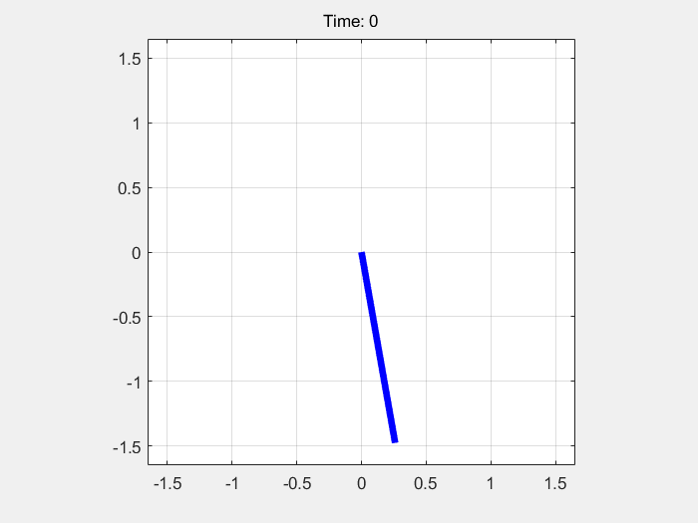
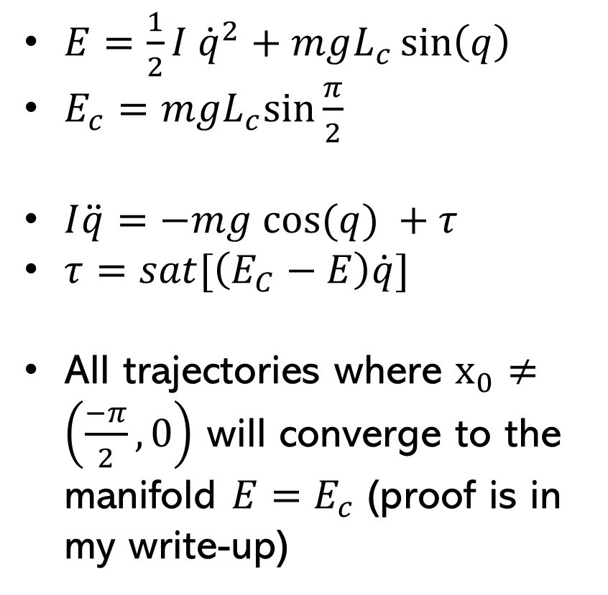
Swing-up Controller
$E=\frac{1}{2}I {\dot{q}}^{2}+mgL_{c}\sin\left(q\right)$
$E_{c}=mgL_{c}sin⁡\frac{π}{2}$
$I\ddot{q}=−mg cos⁡(q) +τ$
$τ=sat[\left(E_{C}−E\right)\dot{q}]$
All trajectories where $x_{0}≠\left(\frac{−π}{2},0\right)$ will converge to the manifold $E=E_{c}$ (proof is in my write-up)

Slide 11
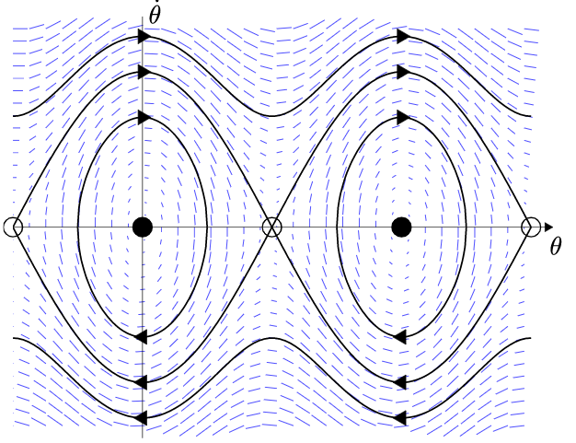
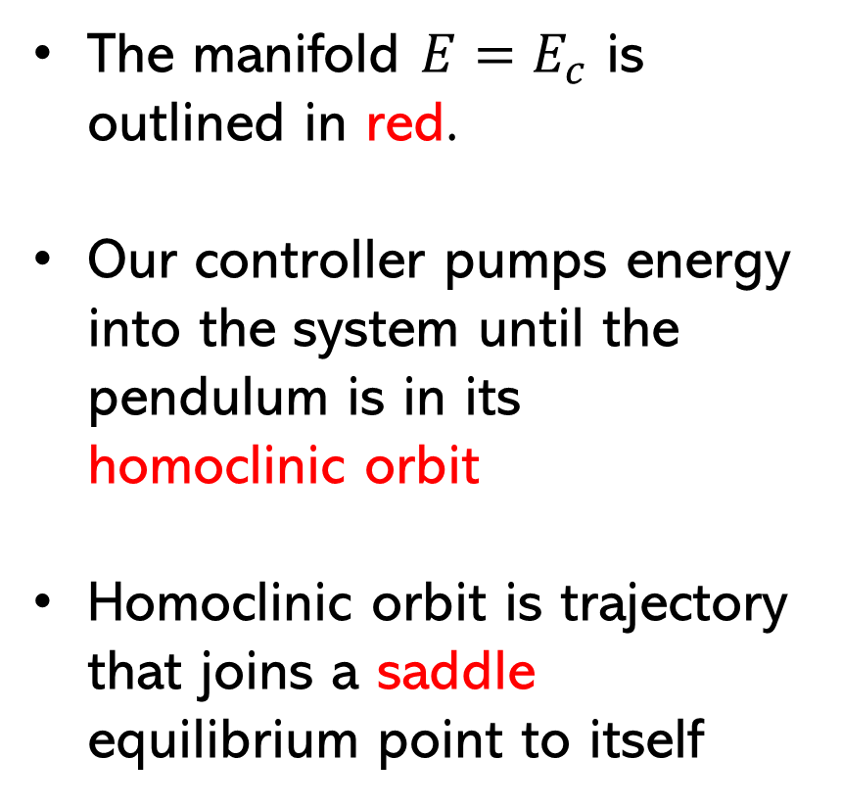
Energy Based Swing-up Control
The manifold $E=E_{c}$ is outlined in red.
Our controller pumps energy into the system until the pendulum is in its homoclinic orbit
Homoclinic orbit is trajectory that joins a saddle equilibrium point to itself
Phase Portrait of undamped Pendulum [1]

Slide 12
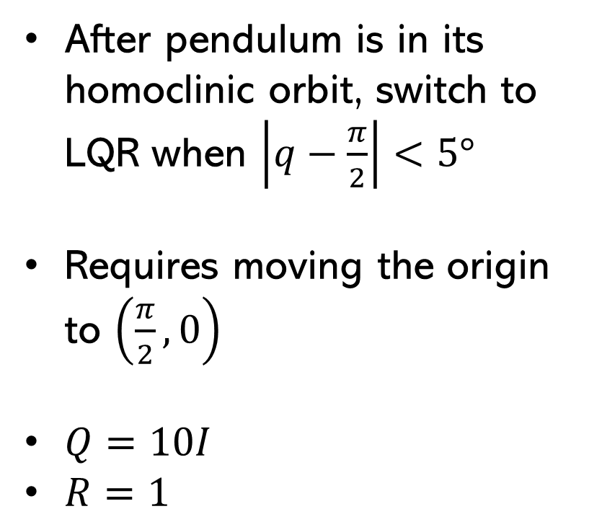
Swing-up + LQR
After pendulum is in its homoclinic orbit, switch to LQR when $\left|q−\frac{π}{2}\right|<5°$
Requires moving the origin to $\left(\frac{π}{2},0\right)$
$Q=10I$
$R=1$

Slide 13
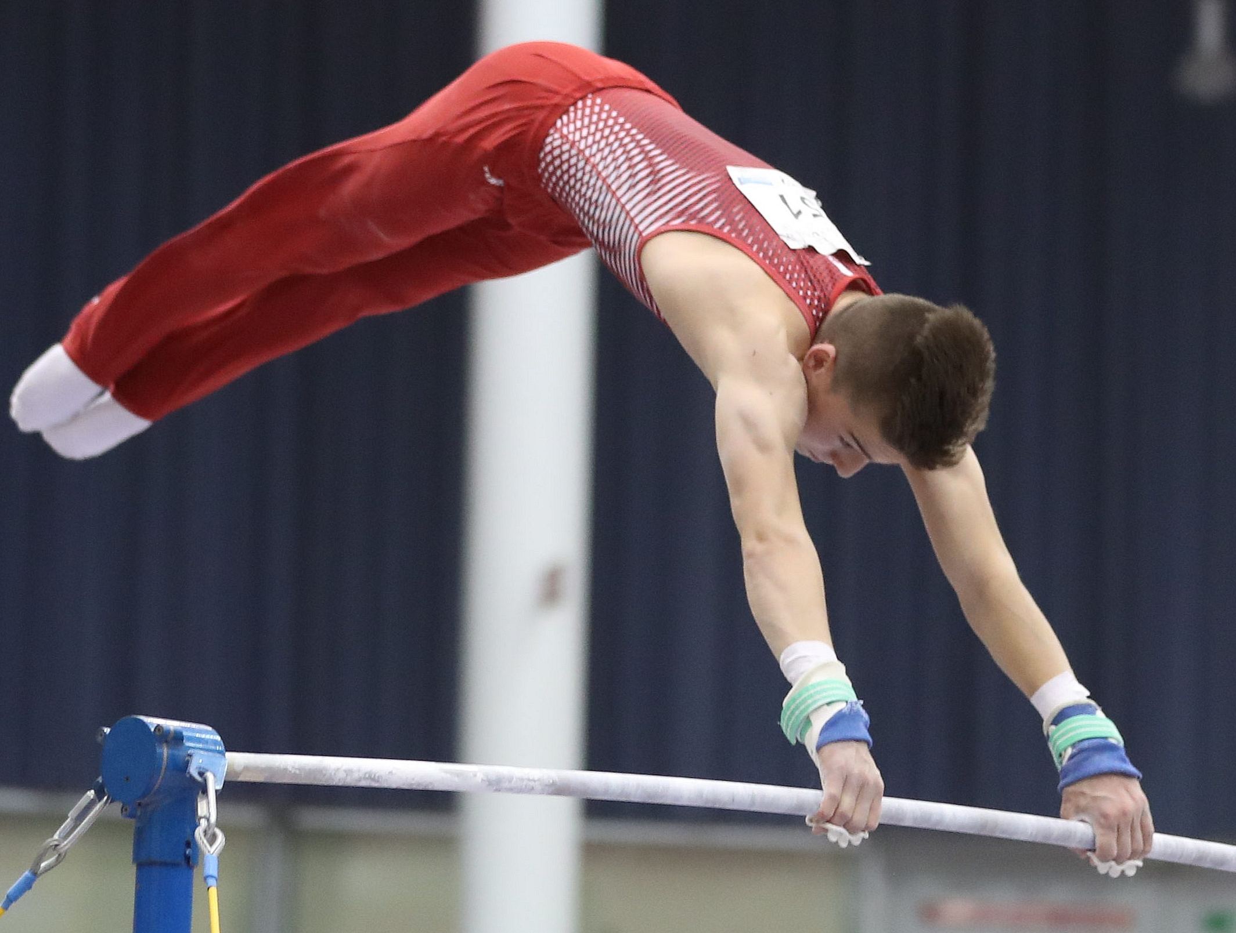
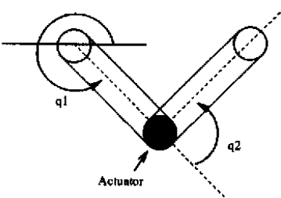
What is the Acrobot?
Double pendulum with one motor located at the “hip”
Spins freely at the “wrist”
2 degrees of freedom
1 actuator
Acrobat (Wikipedia)
Acrobot [2]

Slide 14
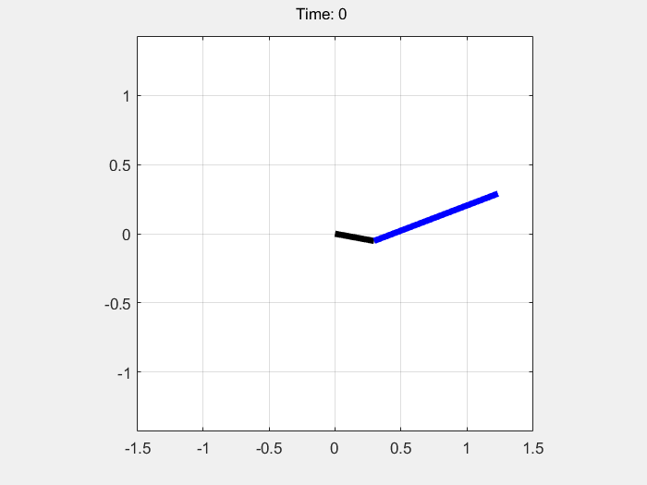
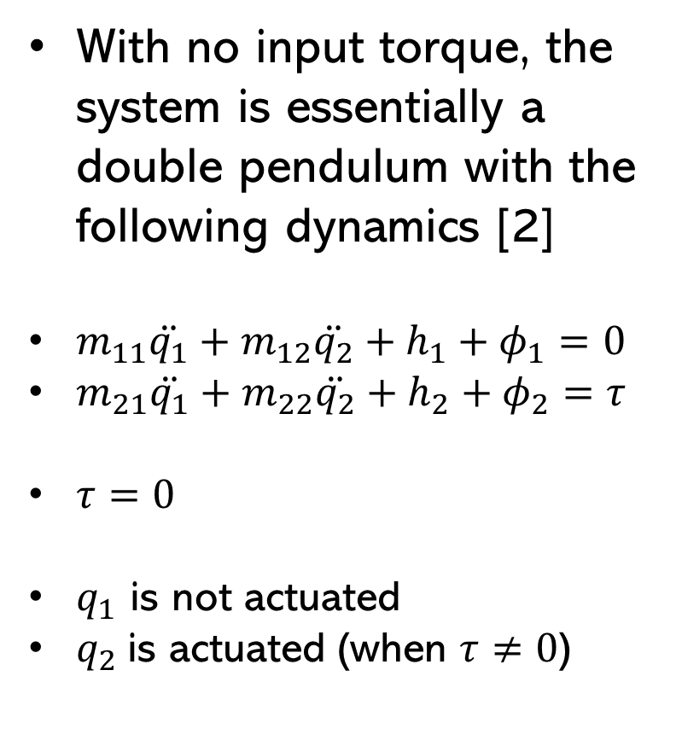
No Input
With no input torque, the system is essentially a double pendulum with the following dynamics [2]
$m_{11}\ddot{q_{1}}+m_{12}\ddot{q_{2}}+h_{1}+φ_{1}=0$
$m_{21}\ddot{q_{1}}+m_{22}\ddot{q_{2}}+h_{2}+φ_{2}=τ$
$τ=0$
$q_{1}$ is not actuated
$q_{2}$is actuated (when $τ≠0$)

Slide 15
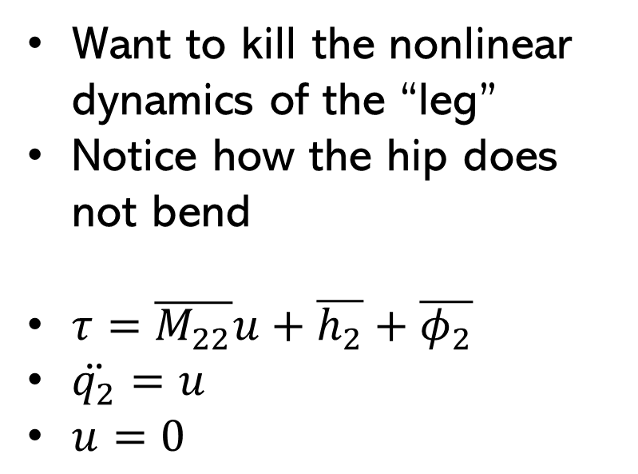
Partial Feedback Linearization
Want to kill the nonlinear dynamics of the “leg”
Notice how the hip does not bend
$τ=\overline{M_{22}}u+\overline{h_{2}}+\overline{φ_{2}}$
$\ddot{q_{2}}=u$
$u=0$

Slide 16
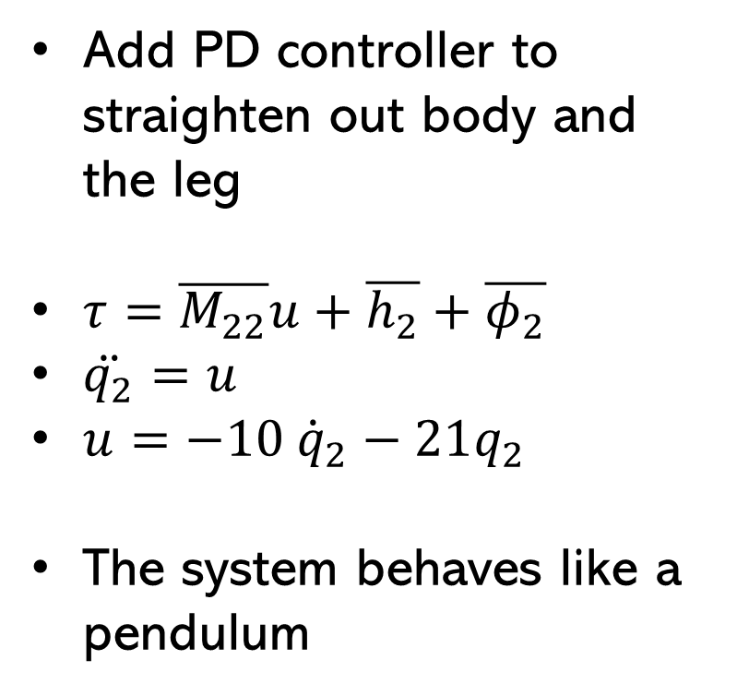
Partial Feedback Linearization
Add PD controller to straighten out body and the leg
$τ=\overline{M_{22}}u+\overline{h_{2}}+\overline{φ_{2}}$
$\ddot{q_{2}}=u$
$u=−10 {\dot{q}}_{2}−21q_{2}$
The system behaves like a pendulum

Slide 17
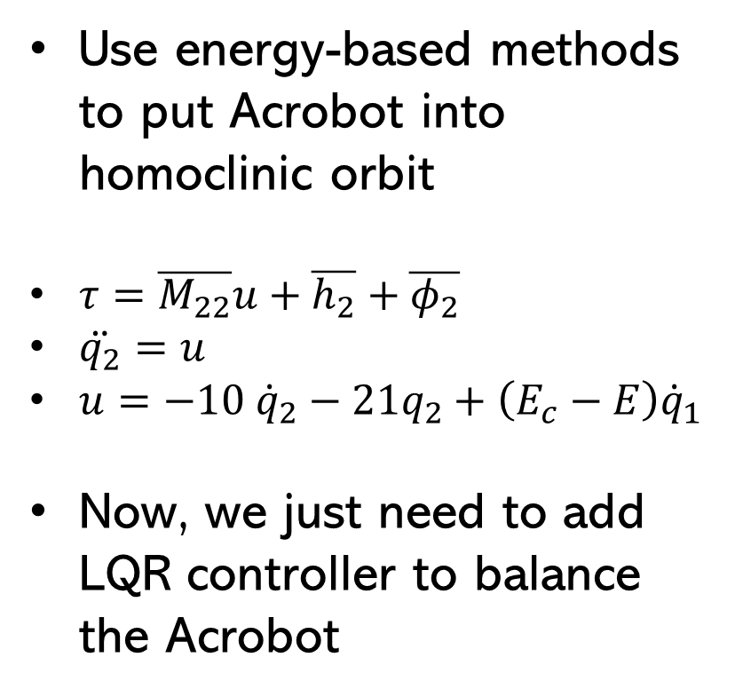
Swing-up Control
Use energy-based methods to put Acrobot into homoclinic orbit
$τ=\overline{M_{22}}u+\overline{h_{2}}+\overline{φ_{2}}$
$\ddot{q_{2}}=u$
$u=−10 {\dot{q}}_{2}−21q_{2}+\left(E_{c}−E\right){\dot{q}}_{1}$
Now, we just need to add LQR controller to balance the Acrobot

Slide 18
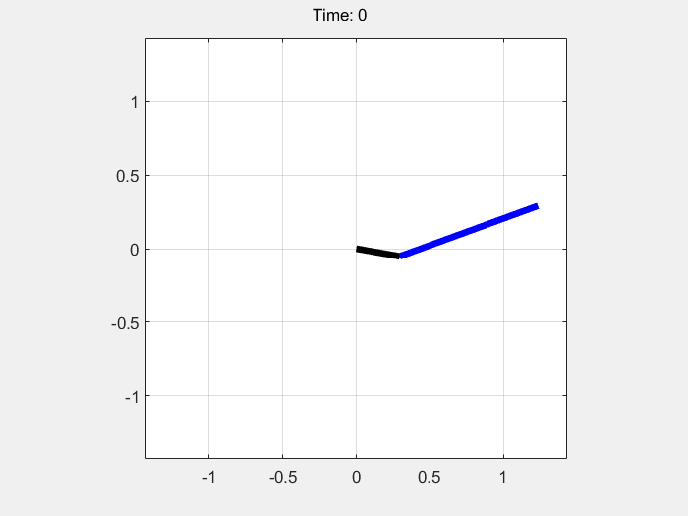
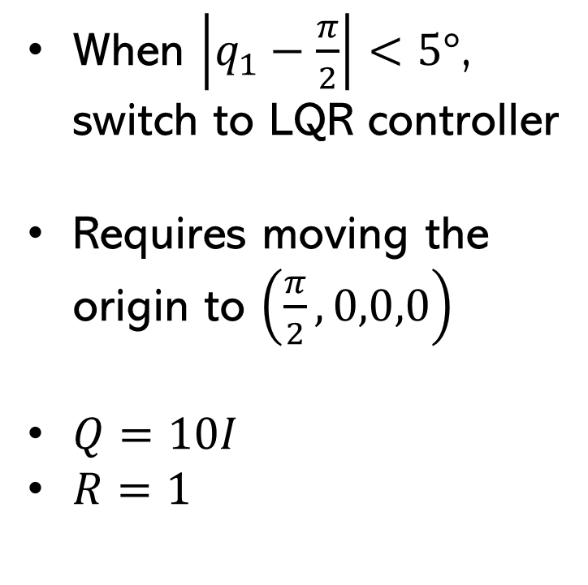
Swing-up Control + LQR (1/2)
When $\left|q_{1}−\frac{π}{2}\right|<5°$, switch to LQR controller
Requires moving the origin to $\left(\frac{π}{2},0,0,0\right)$
$Q=10I$
$R=1$

Slide 19
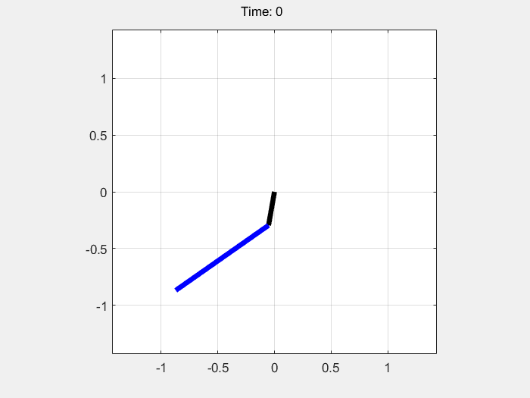
Swing-up Control + LQR (2/2)
Same as before, but with different initial conditions
The kipping is most aggressive around the 13 second mark

Slide 20
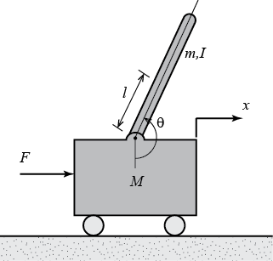
Cart Pole (Inverted Pendulum)
Task: move the cart in order to balance the pole in the vertical position
Method: use PFL to remove the unactuated dynamics.
Use energy methods to swing up the pole
Use LQR to balance the pole
Cart Pole System [3]

Slide 21
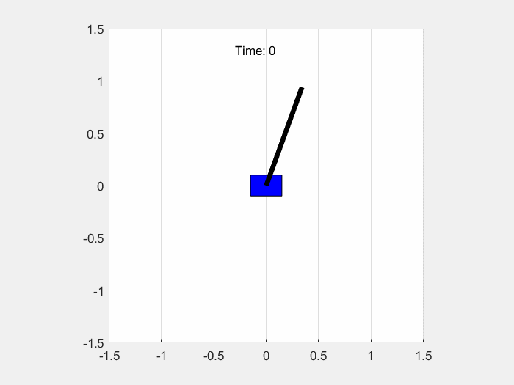
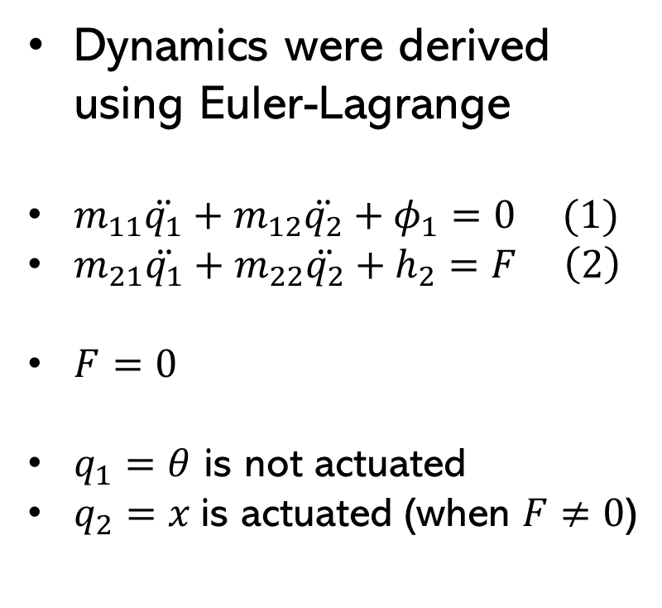
No Input
Dynamics were derived using Euler-Lagrange
$m_{11}\ddot{q_{1}}+m_{12}\ddot{q_{2}}+φ_{1}=0 (1)$
$m_{21}\ddot{q_{1}}+m_{22}\ddot{q_{2}}+h_{2}=F \left(2\right)$
$F=0$
$q_{1}=θ$ is not actuated
$q_{2}=x$is actuated (when $F≠0$)

Slide 22
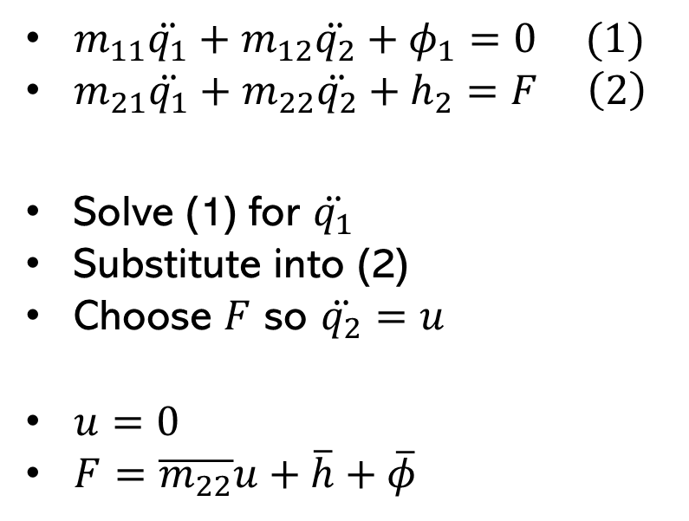
Partial Feedback Linearization
$m_{11}\ddot{q_{1}}+m_{12}\ddot{q_{2}}+φ_{1}=0 (1)$
$m_{21}\ddot{q_{1}}+m_{22}\ddot{q_{2}}+h_{2}=F \left(2\right)$
Solve (1) for $\ddot{q_{1}}$
Substitute into (2)
Choose $F$ so $\ddot{q_{2}}=u$
$u=0$
$F=$ $\overline{m_{22}}u+\overline{h}+\overline{φ}$

Slide 23
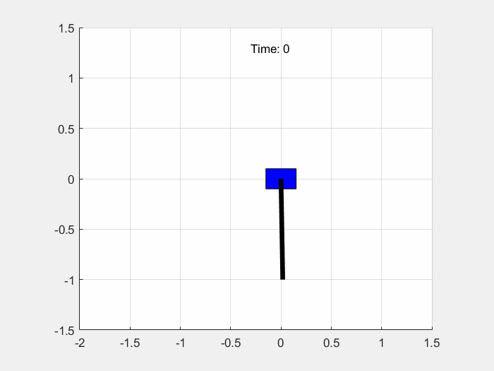
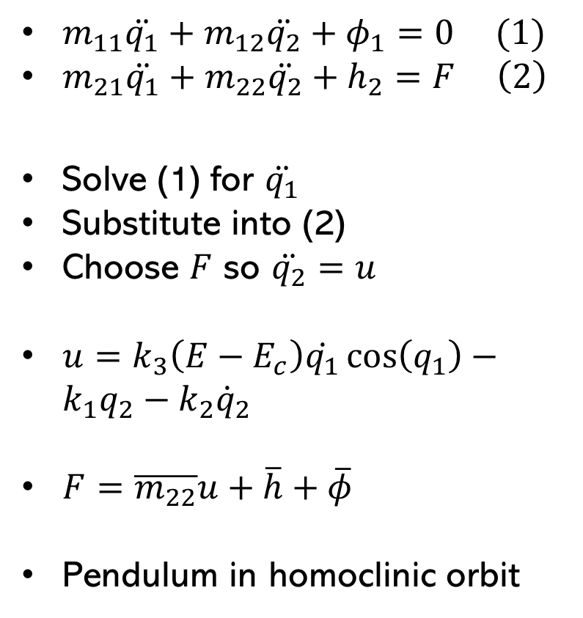
Swing-up Controller
$m_{11}\ddot{q_{1}}+m_{12}\ddot{q_{2}}+φ_{1}=0 (1)$
$m_{21}\ddot{q_{1}}+m_{22}\ddot{q_{2}}+h_{2}=F \left(2\right)$
Solve (1) for $\ddot{q_{1}}$
Substitute into (2)
Choose $F$ so $\ddot{q_{2}}=u$
$u=k_{3}\left(E−E_{c}\right)\dot{q_{1}}\cos\left(q_{1}\right)−k_{1}q_{2}−k_{2}{\dot{q}}_{2}$
$F=$ $\overline{m_{22}}u+\overline{h}+\overline{φ}$
Pendulum in homoclinic orbit

Slide 24
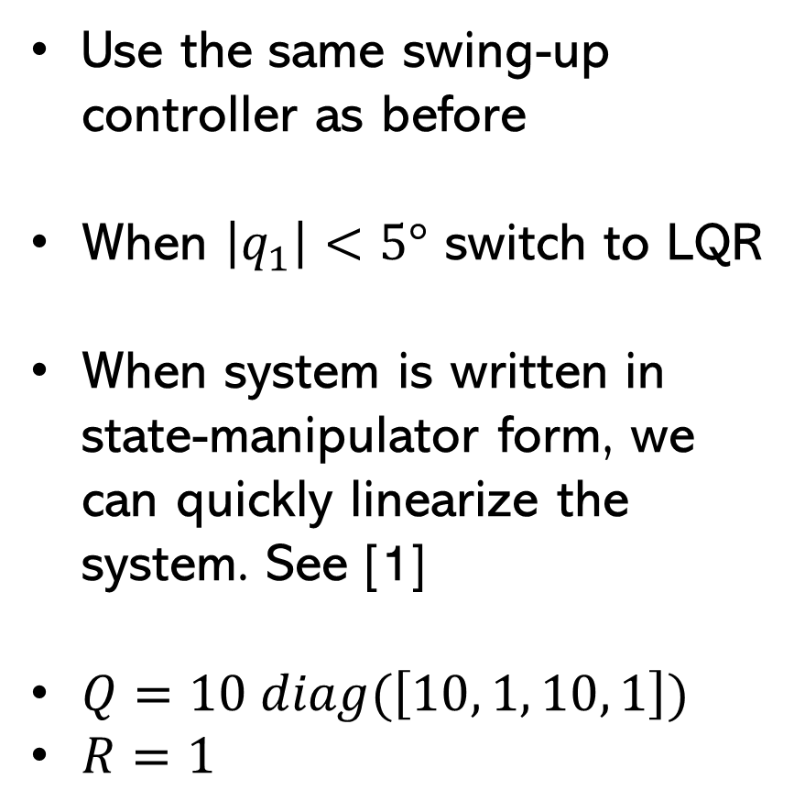
Swing-up + LQR
Use the same swing-up controller as before
When $\left|q_{1}\right|<5°$ switch to LQR
When system is written in state-manipulator form, we can quickly linearize the system. See [1]
$Q=10 diag(\left[10, 1, 10, 1\right])$
$R=1$

